Slide 2
Debunk Myths About CTE A practical guide to understand and demystify Common Table Expressions in SQL Servers
Uwe Ricken

Slide 3

Links for this Session/Workshop
Scripts and Slide Decks https://github.com/db-berater/Debunk-Myths-about-CTE
ERP Demo Database (6.00 GB) https://db-berater.de/downloads/ERP_Demo.bak
SQLQueryStress https://github.com/ErikEJ/SqlQueryStress

Slide 4




Uwe Ricken db Berater GmbH
I am working with IT-systems since early 1990's and with the main focus on Microsoft SQL Server since version 6.0. I started with development of database applications in 1998 with a professional CRM-System based on Microsoft products (Microsoft Office and Microsoft SQL Server).
Since 2008 I'm focused exclusively on Microsoft SQL Server and working in 3rd level support teams for banks, insurances and global industries.
Since May 2013 I am a Microsoft Certified Master: SQL Server 2008 which was an amazing way into the depth of Microsoft SQL Server.
In July 2013 I have been awarded with the MVP Award for Microsoft SQL Server.
www: http://www.db-berater.de
email: uwe.ricken@db-berater.de
blog: http://www.sqlmaster.de
BlueSky: @sqlbambi

Slide 5

Challenge SQL Server real world scenarios
Get a challenge at least once a month
Connect to a provided SQL Server Instance
Load the challenge scenario
Try to solve it
Blog about your solution
Leave a link in the comments of the challenge to your blog post.
https://sqlchallenges.de

Slide 6
Agenda
Introduction to CTE (Common Table Expressions)
Why CTEs Matter: Use Cases and Syntax
Myths about CTEs
Execution Plan Deep Dive: What really happens
Understanding Query Execution Phases
Q & A and Discussion

Slide 7
What is a CTE
CTE = Common Table Expression

Slide 8
What is a CTE (Common Table Expression)
CTE stands for Common Table Expression
Introduced in SQL Server 2005
Acts as a temporary named result set!
Improves readability and modularity of complex queries
Can be recursive or non-recursive
Often used for
Simplifying nested queries
Breaking down logic into logical steps
Because of recursion it is often used for hierarchical data

Slide 9
How regular CTEs work
/* beginning the definition with the name of the CTE */
WITH o [(column_list)] AS
(
SELECT l.l_partkey
FROM dbo.orders AS o
INNER JOIN dbo.lineitems AS l
ON (o.o_orderkey = l.l_orderkey)
WHERE o_orderdate >= '2019-01-01’
AND o_orderdate < '2020-01-01'
)
SELECT COUNT_BIG(*) AS total_order_count
FROM o INNER JOIN dbo.parts AS p
ON (o.l_partkey = p.p_partkey)
WHERE p.p_brand = 'Brand#23';

Slide 10

How regular CTEs work

Slide 11
How recursive CTEs work
;WITH d /* beginning the definition with the name of the CTE */
AS
(
SELECT CAST(GETDATE() AS DATE) AS date_column /* Anchor with the first set */
UNION ALL
SELECT DATEADD(DAY, 1, date_col) AS date_column /* Sub Set referring to previous set */
FROM d
WHERE d.date_column <= DATEADD(DAY, 7, GETDATE()) /* Termination condition */
)
SELECT *
FROM d
[WHERE d.date_col <= DATEADD(DAY, 7, GETDATE())]
[OPTION MAXRECURSION n); /* n = number of iterations */
GO

Slide 12
How recursive CTEs work

Slide 13
Myths about CTEs in SQL Server
CTE = Common Table Expression

Slide 14
Myths About CTEs in SQL Server
CTEs Improve Performance
CTEs Are Materialized
CTEs Can Be Reused Multiple Times with ONE call
Recursive CTEs Are Always Efficient
CTEs Replace Subqueries Completely
CTEs [CAN] turn down the performance of queries. Better choice are subqueries.

Slide 15
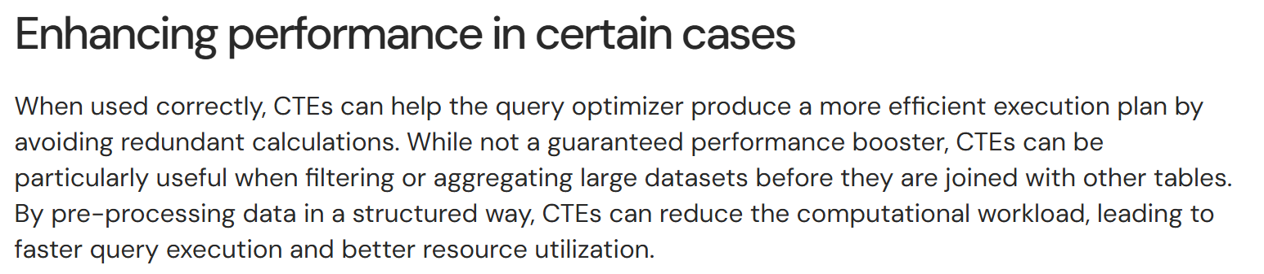
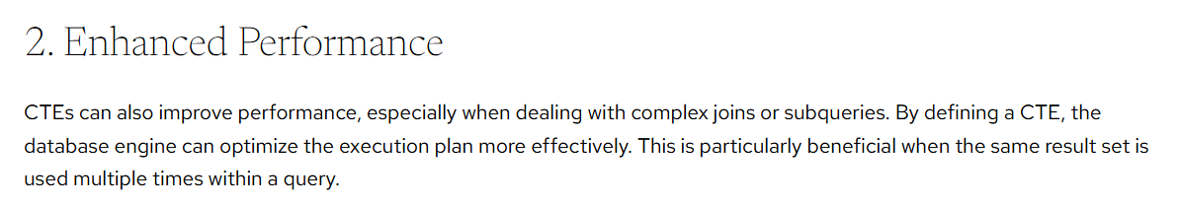
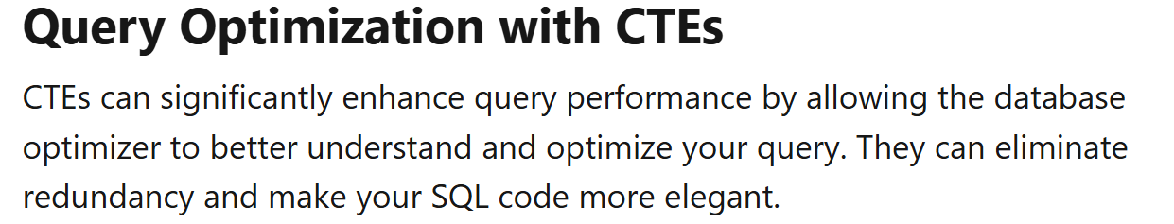
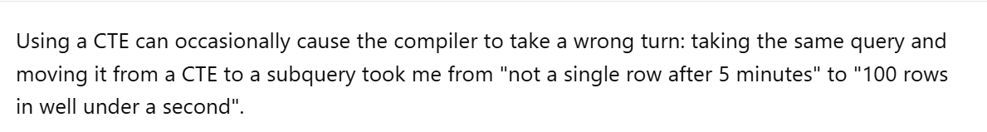
What does the expert say about this?

Slide 16
CTEs Improve Performance

Slide 17
What is the query with best performance?
Query #1 | Query #2 | Query #3
SELECT c.c_custkey, c.c_name FROM dbo.customers AS c INNER JOIN dbo.nations AS n ON (c.c_nationkey = n.n_nationkey) INNER JOIN dbo.regions AS r ON (n.n_regionkey = r.r_regionkey) WHERE c.c_mktsegment = 'AUTOMOBILE' AND n.n_name = 'Slovenia' ORDER BY c.c_custkey; | SELECT c.c_custkey, c.c_name FROM ( SELECT * FROM dbo.customers AS c WHERE c.c_mktsegment = 'AUTOMOBILE’ ) AS c INNER JOIN ( SELECT * FROM dbo.nations AS n WHERE n.n_name = 'SLOVENIA’ ) AS n ON (c.c_nationkey = n.n_nationkey) INNER JOIN ( SELECT * FROM dbo.regions AS r ) AS r ON (r.r_regionkey = n.n_regionkey) ORDER BY c.c_custkey; | ;WITH c AS ( SELECT * FROM dbo.customers AS c WHEREc.c_mktsegment = 'AUTOMOBILE’ ), n AS ( SELECT * FROM dbo.nations AS n WHEREn.n_name = 'SLOVENIA’ ), r AS ( SELECT * FROMdbo.regions AS r ) SELECT c.c_custkey, c.c_name FROM r INNER JOIN n ON (r.r_regionkey = n.n_regionkey) INNER JOIN c ON (c.c_nationkey = n.n_nationkey) ORDER BY c.c_custkey;

Slide 18
CTEs improve Performance

Slide 19
CTEs Are Materialized

Slide 20
CTEs are materialized
Not in Microsoft SQL Server
This claim is often made in connection with the one-time delivery of a statement in a CTE.
Recursive CTEs are a special case
they may use spooling internally
this is an execution plan optimization but not a “feature” of a CTE!
PostgreSQL supports materialized CTEs
Starting with Postgres 12 CTE can be materialized by using the keywords MATERIALIZED

Slide 21
CTEs are materialized

Slide 22
CTEs are executed once…
but can be used multiple times!

Slide 23
CTEs are executed once…

Slide 24
Understanding Query Execution Phases
Why CTEs are not “magic”!

Slide 25

Readability and Modularity
SQL IS A DECLARATIVE PROGRAMMING LANGUAGE
You specify the desired result, not the step-by-step procedure.
The Query Optimizer decides the execution strategy (e.g., optimization, parallelism).
SELECT c_custkey
c_name
FROM dbo.customers AS c
INNER JOIN dbo.nations AS n
ON (c.c_nationkey = n.n_nationkey)
INNER JOIN dbo.regions AS r
ON (n.n_regionkey = r.r_regionkey)
WHERE c.c_mktsegment = 'AUTOMOBILE'
AND n.n_name = 'Slovenia'
AND r.r_name = ‘Europe';
Give me the customer key and customer name from customers in Slovenia in Europe which are in the market segment “AUTOMOBILE”

Slide 26
Commutative Law in relational algebra
The commutative law states: a ∘ b = b ∘ a, where ∘ is a binary operation.
The order of operands does not affect the result for certain operations.
UNION (∪)
(R ∪ S) = (S ∪ R)
Intersection (∩)
(R ∩ S) = (S ∩ R)
JOIN (⋈)
(R ⋈ S) = (S ⋈ R) Only true for natural joins or theta joins with symmetric conditions
Enables query optimization: SQL engines can reorder joins or unions for better performance.
Helps in rewriting queries without changing their meaning.

Slide 27
From Parsing to Execution
PARSING
Parsing is breaking down the query into a structured form, checking its syntax and semantics before it can be optimized and executed.
Syntax Check
The database verifies that the SQL statement follows the correct grammar rules.
Semantic Check
Beyond grammar, the parser checks whether the objects referenced exists
Results in a Parse Tree
The query is transformed into a data structure (often called a parse tree or query tree) that represents the logical components of the SQL statement.
LogOp_Project QCOL: [c].c_custkey QCOL: [c].c_name
LogOp_Select
LogOp_Join
LogOp_Join
LogOp_Get TBL: dbo.customers(alias TBL: c)
LogOp_Get TBL: dbo.nations(alias TBL: n)
ScaOp_Comp x_cmpEq
ScaOp_Identifier QCOL: [c].c_nationkey
ScaOp_Identifier QCOL: [n].n_nationkey
LogOp_Get TBL: dbo.regions(alias TBL: r)
ScaOp_Comp x_cmpEq
ScaOp_Identifier QCOL: [n].n_regionkey
ScaOp_Identifier QCOL: [r].r_regionkey
...
SELECT c.c_custkey,
c.c_name
FROM dbo.customers AS c
INNER JOIN dbo.nations AS n
ON (c.c_nationkey = n.n_nationkey)
INNER JOIN dbo.regions AS r
ON (n.n_regionkey = r.r_regionkey)
WHERE c.c_mktsegment = 'AUTOMOBILE'
AND n.n_name = 'Slovenia'
AND r.r_name = ‘Europe';
GO

Slide 28
From Parsing to Execution
Binding
The binding phase is where SQL Server resolves all identifiers in a query
tables, columns, functions, and data types
against the database catalog, ensuring they exist, are valid, and accessible before optimization and execution.
Ensures that each column name exists in the specified table or view.
Determines the data types of expressions and columns.
Verifies that built-in or user-defined functions exist and that arguments match expected types.
LogOp_Project QCOL: [c].c_custkey QCOL: [c].c_name LogOp_Select LogOp_Join LogOp_Join LogOp_Get TBL: dbo.customers(alias TBL: c) LogOp_Get TBL: dbo.nations(alias TBL: n) ScaOp_Const TI(bit,ML=1) XVAR(bit,Not Owned, Value=1) LogOp_Get TBL: dbo.regions(alias TBL: r) ScaOp_Const TI(bit,ML=1) XVAR(bit,Not Owned,Value=1) ScaOp_Logical x_lopAnd ScaOp_Comp x_cmpEq ScaOp_Identifier QCOL: [c].c_nationkey ScaOp_Identifier QCOL: [n].n_nationkey ScaOp_Comp x_cmpEq ScaOp_Identifier QCOL: [n].n_regionkey ScaOp_Identifier QCOL: [r].r_regionkey

Slide 29
From Parsing to Execution
Normalization
After parsing and binding, SQL Server performs normalization:
Simplifies expressions (e.g., WHERE NOT (A = B) => WHERE A <> B).
Expands views and inline functions into their underlying definitions.
Applies logical rewrites to make the query tree more consistent for optimization.
Ensures equivalent queries are represented in a uniform internal form.
SELECT * FROM dbo.customers WHERE c_custkey <= 10;
ScaOp_Comp x_cmpLe
ScaOp_Identifier QCOL: [dbo].[customers].c_custkey
ScaOp_Const TI(bigint,ML=8) XVAR(bigint,Not Owned,Value=10)
SELECT * FROM dbo.customers WHERE NOT (c_custkey > 10);
ScaOp_Comp x_cmpLe
ScaOp_Identifier QCOL: [dbo].[customers].c_custkey
ScaOp_Const TI(bigint,ML=8) XVAR(bigint,Not Owned,Value=10)

Slide 30
From Parsing to Execution
Optimization
The optimization phase is where the database engine decides how to execute your query most efficiently.
Parsing and binding tell SQL Server what you want, but optimization decides how to get it.
What happens during Optimization
Logical rewrites
Plan Alternatives Generation
Cost Estimation
Plan Selection

Slide 31
Rewrite (Optimization)
Rewriting
Rewrite refers to the set of logical transformations applied to the query tree before and during cost-based plan exploration.
These rewrites don’t change the result of the query.
They change its form so the optimizer can reason about it more effectively and potentially find cheaper execution strategies by applying rules.
Examples for Rules
SelPredNorm: Normalize selection predicates
RemoveSubqInSel: Eliminates scalar subqueries
SelOnTrue: Removes filters which always return “true”
…
SELECT c_custkey,
c_name,
c_mktsegment
FROM dbo.customers AS c
WHERE c_custkey <= 10
AND 1 = (SELECT 1);
/* Rewritten by the Optimizer */
SELECT c_custkey,
c_name,
c_mktsegment
FROM dbo.customers AS c
WHERE c_custkey <= 10;

Slide 32
Readability and Modularity

Slide 33
Query Optimization Tree
Input Tree
Initial representation before optimization begins
Converted Tree
Logical tree construction
Simplified Tree
Predicate pushdown
Join Collapse Tree
Structural simplification
Tree before Project Normalization
Pre-final projection shaping
Tree after Project Normalization
Final logical tree
SELECT c.c_custkey,
c.c_name
FROM dbo.customers AS c
INNER JOIN dbo.nations AS n
ON (c.c_nationkey = n.n_nationkey)
WHERE c.c_mktsegment = 'AUTOMOBILE’
AND n.n_name = 'Slovenia’;

Slide 34
Rewrite (Normalization) operates on the logical operator tree but not on the written SQL

Slide 35
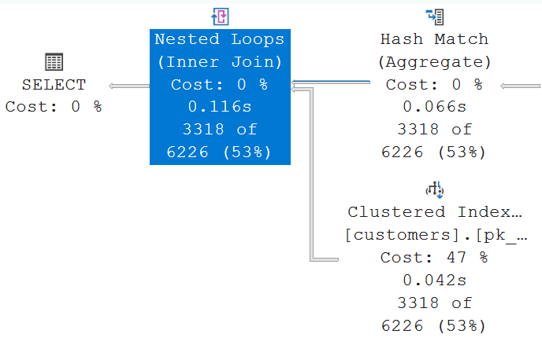
Decorrelation
SELECT c.c_custkey,
c.c_name
FROM dbo.customers AS c
WHERE EXISTS
(
SELECT *
FROM dbo.orders AS o
WHERE o.o_custkey = c.c_custkey
AND o_orderdate = '2019-01-01’
);

Slide 36
Best Practice Tip
Use CTEs for clarity and modularity, not for performance gains.
If performance is critical, inspect the execution plan and consider alternatives
indexed temp tables or
query refactoring

Slide 37
https://github.com/db-berater/Debunk-Myths-about-CTE

